Slide 2

Workshop 5. LLM Integration & Prompt Engineering
LLM API
Integration
Prompt Engineering

Slide 3
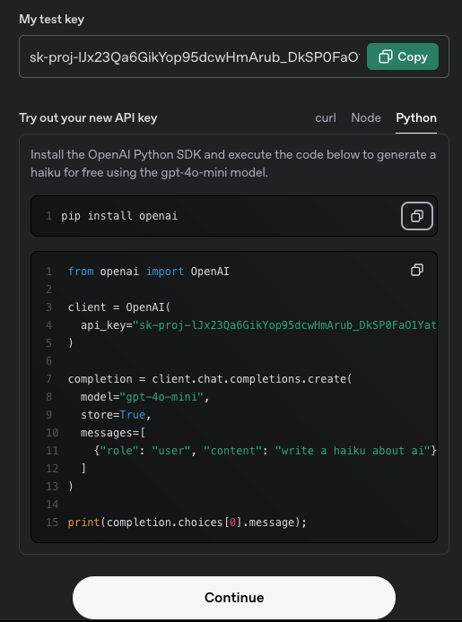

Integrate LLM service using Python
LLM API - OpenAI
1. Get API Key
Go to https://platform.openai.com and signup
Go to the API Keys section under account settings
Copy the key to your settings.py file

Slide 4
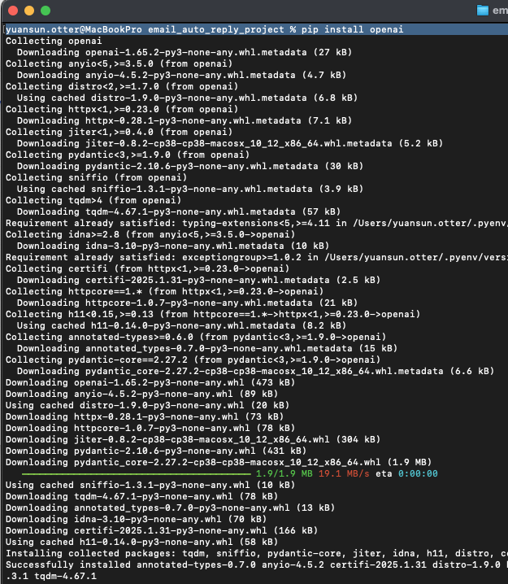
Integrate LLM service using Python
LLM API - OpenAI
2. Install OpenAI SDK in Python
In the directory where you start the local server
$ pip install openai

Slide 5
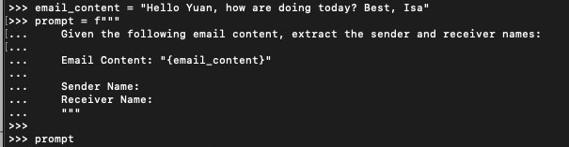
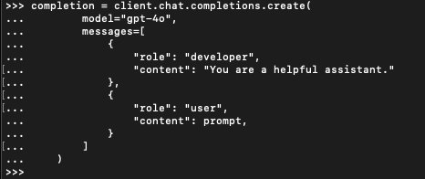
Integrate LLM service using Python
LLM API - OpenAI
3. Make your first API call
Write a prompt
Make request
Check response

Slide 6
Workshop 5. LLM Integration & Prompt Engineering
LLM API
Integration
Prompt Engineering

Slide 7
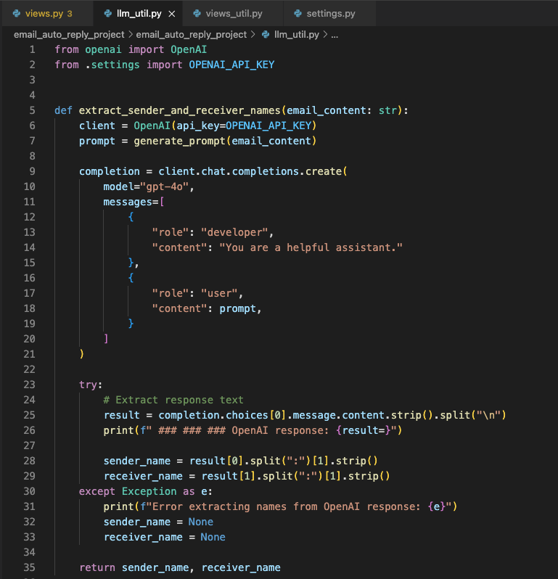
Integrate LLM service using Python
LLM API - OpenAI
4. Integrate into your application
llm_util.py

Slide 8
Integrate LLM service using Python
LLM API - OpenAI
5. Test and troubleshooting
Indeterminate response
Result = completion.choices[0].message.content.strip().split("\n")
Examples
result=['Sender Name: Jennie ', 'Receiver Name: Yuan']
result=['Based on the provided email content:', '', 'Sender Name: Jennie ', 'Receiver Name: Yuan']
Solution
Sol. 1. Regular expression, string parsing.
Sol. 2. Improve the prompt and ask for a determinate result.

Slide 9
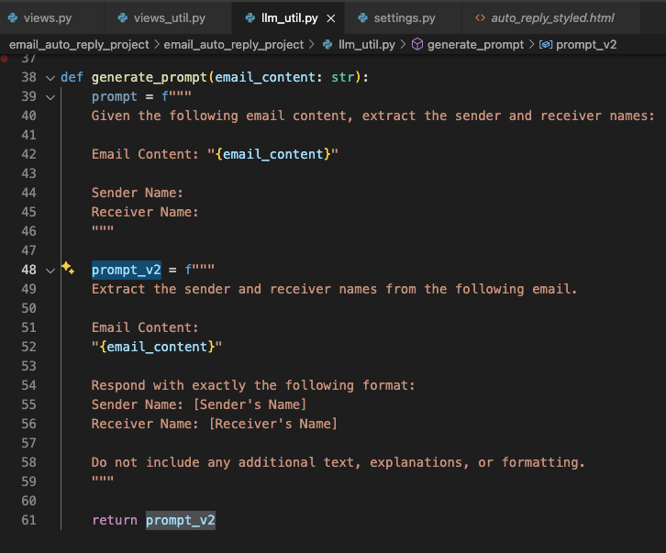
Integrate LLM service using Python
LLM API - OpenAI
5. Test and troubleshooting
llm_util.py

Slide 10

Any questions?

Slide 11
Integrate LLM service using Python
LLM API Integration
Get API Key
Install SDK in Python, or other languages
Make and test API call
Integrate into your application
Test and troubleshooting
Challenge
Unlike traditional API, LLM might return indeterminate responses thus causing unpredictable behaviors.

Slide 12
Workshop 5. LLM Integration & Prompt Engineering
LLM API
Integration
Prompt Engineering

Slide 13
Integrate LLM service using Python
LLM API – Prompt Engineering
What is prompt engineering?
Prompt Engineering is the practice of designing and optimizing prompts to improve the performance of large language models (LLMs).
It involves crafting effective instructions, examples, and context to guide the model toward generating better responses.

Slide 14
Integrate LLM service using Python
LLM API – Prompt Engineering Techniques
1. Use Clear and Specific Instructions
"Reply this email"
"Reply this email, with a proper receiver and a sender name extracted from the email. Respect and address the senders concerns and inform them that I will be back from PTO by the end of February."

Slide 15
Integrate LLM service using Python
LLM API – Prompt Engineering Techniques
2. Use Chain of Thought (CoT) Reasoning
"Reply the email"
"""Reply this email by following the steps below,
Firstly read through the email and identify if it's an inquiry email from a customer;
Secondly recognize the sender's name and receiver's name;
Then compose a reply email address the customers' concerns or questions, if any, from the email;
Inform them that I will be back from PTO by end of February;
Finally, ensure the right sender and receiver's names are included in this email with proper greetings."""

Slide 16
Any questions?

Slide 17
Integrate LLM service using Python
LLM API – Prompt Engineering Techniques
3. Few-Shot Prompting - Giving Examples
"Reply this email with a receiver and a sender name extracted from the email."
"""Reply this email with a receiver and a sender name extracted from the email. For example,
Example 1.
"Hi Foo, what's my order status? Thanks, Bryan."
The receiver is Foo and sender is Bryan in the reply email.
Example 2.
"How are you doing John? What's my order status? The order number is 666888 and name is Kay. Thanks!"
The receiver is Kay and sender is John in the reply email."""

Slide 18
Integrate LLM service using Python
LLM API – Prompt Engineering Techniques
4. Roles Specification for Contextual Accuracy
"Reply this email and address the questions."
"""You are a supply chain manager in a semiconductor company, and in charge of customers' orders management.
Your responsibility includes but not limited to,
Answer customers' questions about orders status;
Overwrite and update customers' orders status upon requesting;
However, you are on PTO now and will be back by end of February.
You need to reply customers emails asking for help with orders, address their concerns and acknowledge their request will be processed once you are back to office."""

Slide 19
Integrate LLM service using Python
LLM API – Prompt Engineering Techniques
5. Formatting Output for Clarity
"""Given the email content {email_content}, extract the sender and receiver names."""
"""Extract the sender and receiver names from the following email.
Email Content: "{email_content}"
Respond with exactly the following format:
Sender Name: [Sender's Name]
Receiver Name: [Receiver's Name]
Do not include any additional text, explanations, or formatting."""

Slide 20
Integrate LLM service using Python
LLM API – Prompt Engineering Techniques
6. Prompt Chaining (Multi-Step Prompts)
Breaking a complex task into multiple sequential prompts where the output of one prompt serves as the input for the next.
Best For: Multi-step tasks like summarization, data extraction, or structured responses.
E.g.
Step 1. "Extract the sender and the receiver names from the email."
Step 2. "Read through the email and identify all questinos and determine if it's from a customer that asking for order status." >> Response: Yes/No
Step 3. "If it's a customer inquiry email, reply the email as you are the supply chain manager addressing the customer's questions, and inform them I will be on PTO until March. The reply email should contain the extracted sender and receiver names. "

Slide 21
Any questions?

Slide 22
Integrate LLM service using Python
LLM API – Prompt Engineering Techniques
7. Set Constraints on the Response
"Reply this email address the customer's question."
"""Reply this email address the customer's question.
However, you will NOT able to cancel customer's orders and that needs to report to the upstream department, if the customer asked."""

Slide 23
Integrate LLM service using Python
LLM API – Prompt Engineering
Techniques
Use Clear and Specific Instructions
Use Chain of Thought (CoT) Reasoning
Few-Shot Prompting - Giving Examples
Roles Specification for Contextual Accuracy
Formatting Output for Clarity
Prompt Chaining (Multi-Step Prompts)
Set Constraints on the Response

Slide 24
Integrate LLM service using Python
LLM API – Prompt Engineering
Your turn to try
Use the techniques for Assignment 2 extracting sender and receiver in emails.
Combine different techniques and try to solve more vague problems,
Imagine emails come from your friends, family, co-workers and clients
How to identify these business inquiry emails? And prompt the LLM to the correct role to reply in different styles but in proper formats.

Slide 25
Workshop 5. LLM Integration & Prompt Engineering
LLM API
Integration
Prompt Engineering
Assignment 2 Reminder

Slide 26
Integrate LLM service using Python
Assignment 2
Submit assignment 2 by March 15. 2025

